Slide 1
Mastering System Design
Section 5: Web Concepts in System Design
System Design Fundamentals

Slide 2
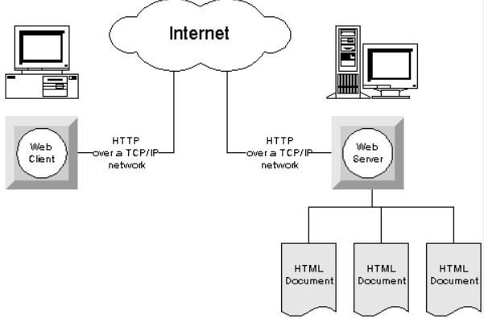
Why Learn Web Concepts?
Importance of web principles in modern system design
Impact on scalability, security, and performance
How understanding these concepts helps in system design interviews

Slide 3
Section Agenda
Web Sessions: Managing State in Web Applications
Serialization: Data Exchange & Storage Formats
CORS: Cross-Origin Resource Sharing & Web Security
Summary & Practical Applications

Slide 4
Web Sessions: Managing State in Web Applications
System Design Fundamentals - Web Concepts

Slide 5
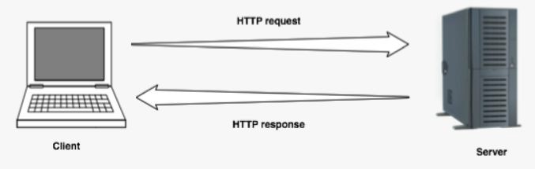
Why Web Sessions Matter?
Web applications often need to track user state (e.g., login status, shopping cart, user preferences)
HTTP is stateless, meaning each request is independent
Goal: Understand how to maintain state in web applications

Slide 6
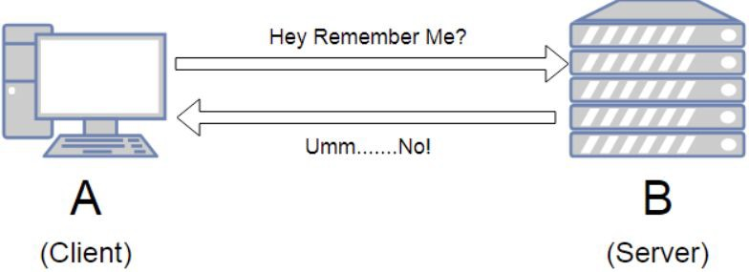
Understanding Statelessness in HTTP
HTTP does not retain memory of previous requests
Each request must contain all necessary information
Why this is a challenge for user sessions

Slide 7
Techniques for Maintaining State
Session-Based Authentication (Server-side session storage + Cookies for session IDs)
  The server maintains session state.
  The client holds only a session ID (usually in a cookie).
Token-Based Authentication (JWTs, OAuth Tokens)
  The session state is embedded within the token itself.
  The server does not need to track user sessions.

Slide 8
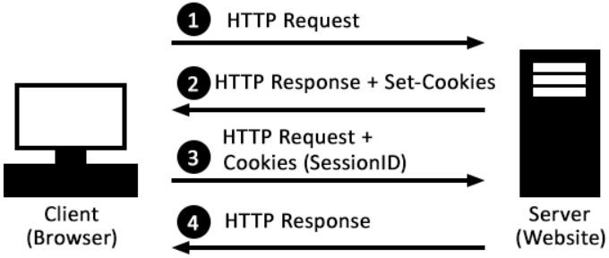
Session-Based Authentication
Server-side session storage
Cookies for session IDs
User logs in → Server creates a session & assigns a session ID
Session data is stored server-side, while session ID is sent to the client
The client stores the session Id in the cookie

Slide 9
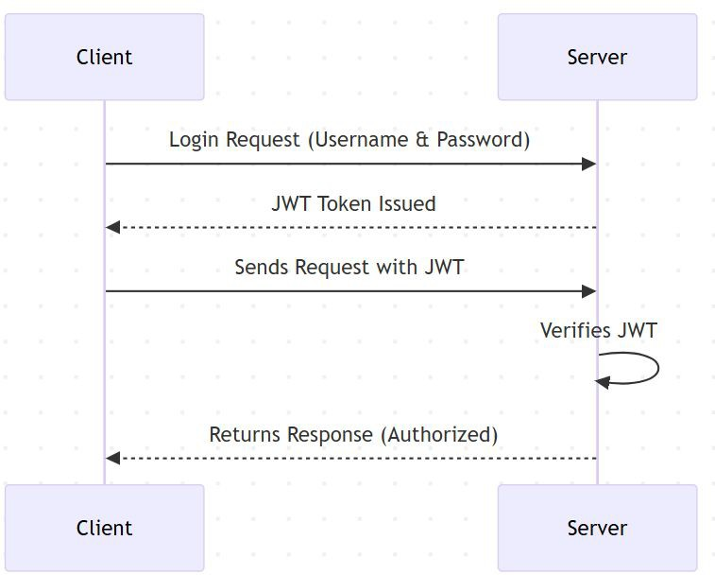
Token-Based Authentication
Encodes session data in a self-contained token
No need for server-side session storage
Used in modern stateless authentication (e.g., OAuth, API tokens)

Slide 10
Security Concerns in Session Management
Session Hijacking: Stolen session IDs
Cross-Site Request Forgery (CSRF): Unauthorized actions
Secure Cookie Handling: Avoiding theft via Secure, HttpOnly, and SameSite ﬂags

Slide 11
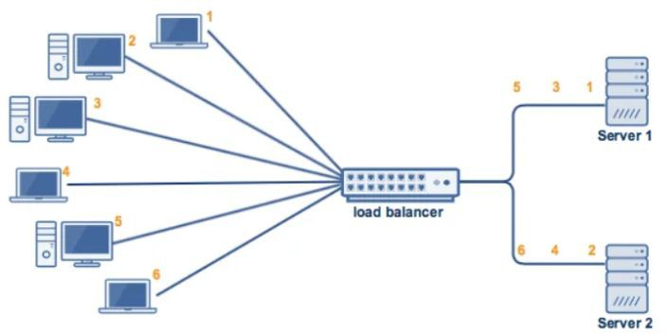
Best Practices for Scaling Session Management
Sticky Sessions vs. Distributed Sessions
Storing session data in Redis, Memcached
Stateless authentication (JWTs) for scalability

Slide 12

Important Interview Questions on Web Sessions
Understanding Statelessness & State Management
  Why is HTTP considered a stateless protocol?
  How do web applications maintain state despite HTTP being stateless?
Session Management Techniques
What are the diﬀerences between server-side sessions and client-side tokens?
When would you use JWT-based authentication instead of session-based authentication? How do cookies and sessions work together in session-based authentication?
Security & Best Practices
What is session hijacking, and how can it be prevented?
How does CSRF exploit session management, and what are the mitigation strategies? Why should cookies be set with Secure, HttpOnly, and SameSite attributes?
How can session management be scaled in distributed systems?
Real-World Scenarios & System Design
  How does a load-balanced system handle session storage?
  In a microservices architecture, how do you manage authentication across multiple services?
  How do large-scale applications like Facebook, Amazon, or Google handle user sessions eﬃciently?
●
○
○
○
●
○
○
○
○
●

Slide 13
Summary & Key Takeaways
HTTP is stateless, requiring session management techniques
Cookies, server-side sessions, JWTs are common methods
Security risks like session hijacking and CSRF must be mitigated
Scaling sessions requires distributed storage solutions
What’s next:
  Serialization: Data Exchange & Storage Formats

Slide 14
Serialization: Data Exchange & Storage Formats
System Design Fundamentals - Web Concepts

Slide 15
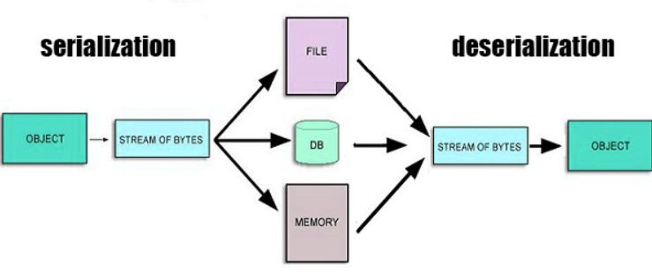
Why Serialization Matters?
Applications need to exchange & store structured data eﬃciently.
Serialization converts complex objects into a format that can be easily transferred.
Used in APIs, databases, caching, and distributed systems.

Slide 16
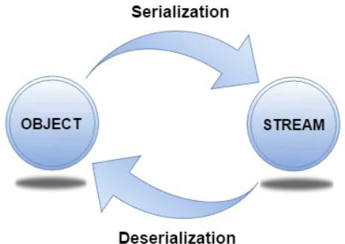
What is Serialization?
Serialization: Converting objects into a format for transmission/storage.
Deserialization: Converting it back into an object.
Essential for distributed systems & inter-process communication.

Slide 17
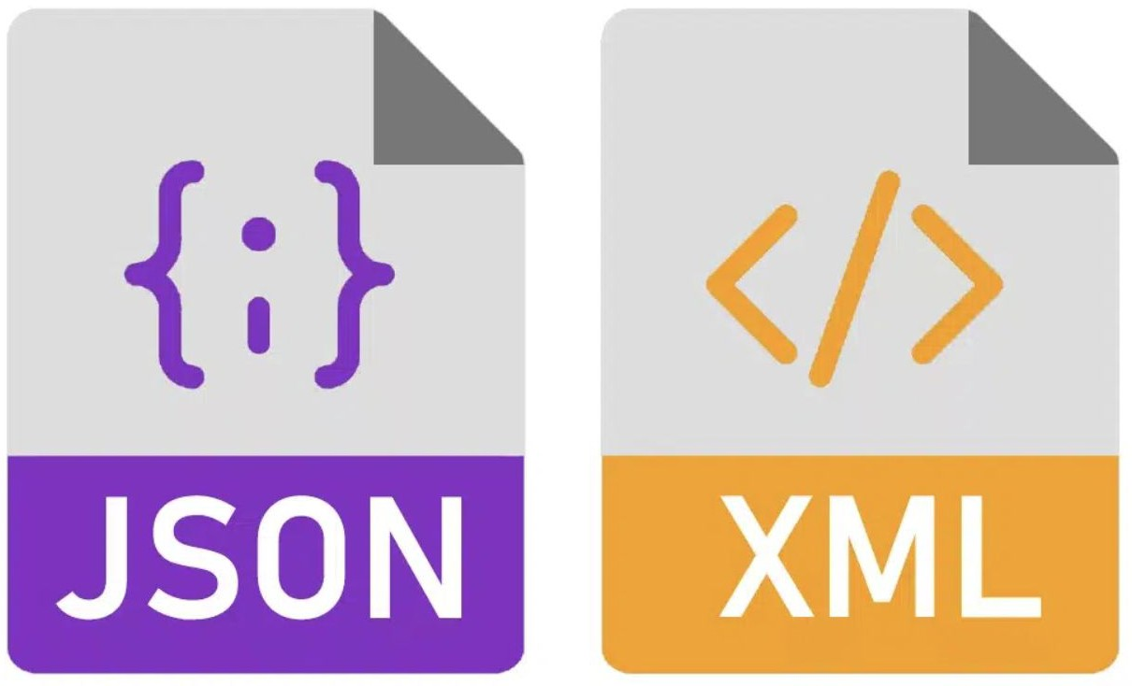

Common Serialization Formats
JSON – Human-readable, widely used in REST APIs.
  Human-readable, widely used in APIs & web applications.
  Simple key-value structure, easy to parse.
  Text-based, so larger in size compared to binary formats.
XML – Structured but verbose, used in legacy systems.
  Tag-based markup language, used in legacy systems & conﬁguration ﬁles.
  More complex than JSON, supports rich data structures.
  Verbose, leading to larger payloads.
Protocol Buﬀers (Protobuf) – Compact & eﬃcient, used in gRPC.
  Binary format developed by Google.
  Faster & smaller than JSON/XML, but requires schema deﬁnition.
  Used in gRPC for high-performance APIs.

Slide 18
Trade-offs: Readability vs. Efﬁciency vs. Compatibility
Readability: JSON & XML are human-readable, but ineﬃcient.
Eﬃciency: Protobuf & Avro are compact, reducing bandwidth usage.
Compatibility: XML support schema evolution, JSON has limited support.

Slide 19
Serialization in action
Serialization in APIs
  REST APIs mostly use JSON.
  gRPC APIs use Protobuf for eﬃciency.
  XML is still used in SOAP-based web services.
Serialization in Caching & Data Storage
  Redis & Memcached: Store serialized JSON/Protobuf data.
  Databases: NoSQL databases like MongoDB use BSON (Binary JSON).
  Big Data: Protobuf used for eﬃcient storage & schema evolution.

Slide 20
Performance Considerations
Serialization choice impacts Bandwidth, CPU, and Memory Usage.
JSON/XML → Larger payloads, slower parsing.
Protobuf → Smaller payloads, faster parsing but needs schema.

Slide 21

Important Interview Questions on Serialization
Understanding Serialization
  What is serialization, and why is it needed in system design?
  How does serialization impact data exchange and storage?
Comparing Serialization Formats
What are the key diﬀerences between JSON, XML, Protocol Buﬀers, and Avro? When would you choose Protobuf over JSON?
Serialization in APIs and Distributed Systems
How does serialization impact API performance and eﬃciency? Why is Protocol Buﬀers commonly used in gRPC instead of JSON?
How does serialization aﬀect caching strategies in systems like Redis?
Performance and Trade-oﬀs
What are the trade-oﬀs between readability, eﬃciency, and compatibility in serialization formats? How does serialization impact CPU and memory usage?
Real-World Applications
How is Avro beneﬁcial in big data systems?
Why do some databases like MongoDB use BSON instead of JSON?
Security Considerations
  What security risks are associated with serialization?
  How can improper deserialization lead to vulnerabilities?
●
○
○
●
○
○
○
●
○
○
●
○
○
●

Slide 22
Summary & Key Takeaways
Serialization enables eﬃcient data exchange & storage.
Choose the right format based on performance, readability, and compatibility.
JSON for APIs, Protobuf for eﬃciency, Avro for big data.
Impacts bandwidth, processing speed, and storage eﬃciency.
What’s next:
  CORS: Cross-Origin Resource Sharing & Web Security

Slide 23
CORS – Cross-Origin Resource Sharing & Web Security
System Design Fundamentals - Web Concepts

Slide 24
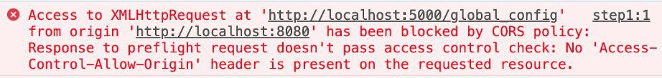
Why CORS Matters? (The Problem & Solution)
The Problem: Browsers enforce Same-Origin Policy (SOP), blocking cross-origin requests by default.
The Need for CORS:
  Modern web apps rely on APIs hosted on diﬀerent domains (e.g., Frontend on app.com, API on api.com).
  CORS is a mechanism that allows secure cross-origin communication.

Slide 25
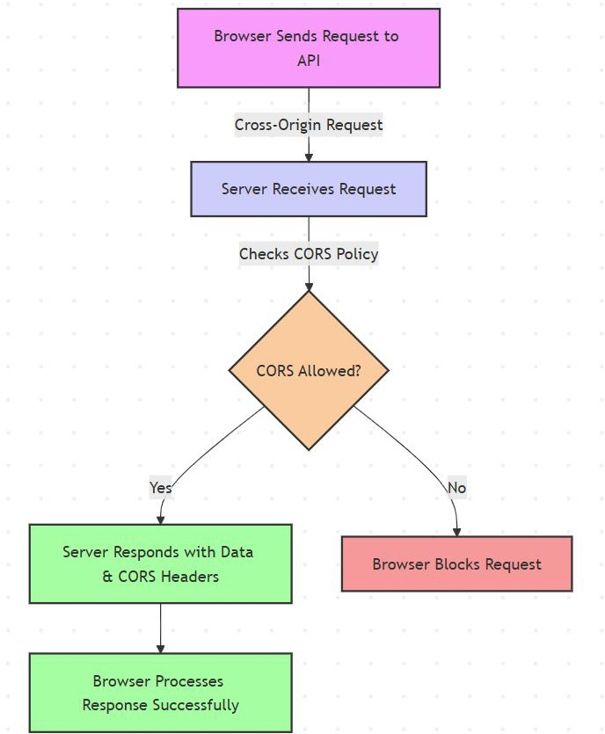
How CORS Works: Requests & Responses
CORS is server-driven – the server must explicitly allow access.
Two types of requests:
  Simple requests: GET, POST (without custom headers).
  Preﬂight requests: Needed for PUT, DELETE, or custom headers.
CORS Headers control:
  Access-Control-Allow-Origin (which origins can access).
  Access-Control-Allow-Methods (allowed HTTP methods).
  Access-Control-Allow-Headers (custom headers that can be sent).

Slide 26
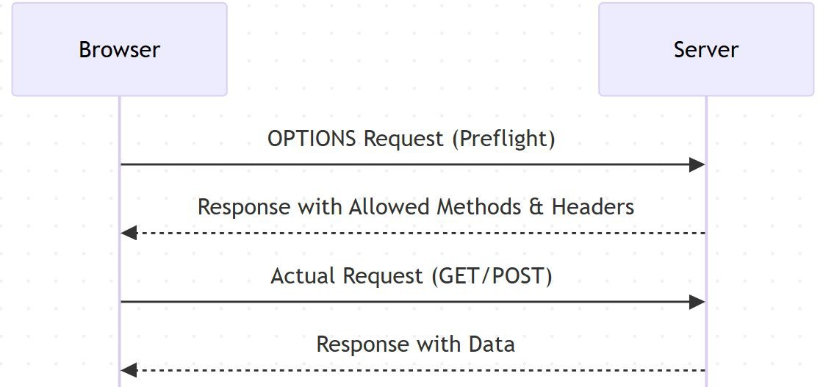
Preﬂight Requests & CORS Headers
Some requests require preﬂight checks (sent via OPTIONS request).
Browser ﬁrst sends a preﬂight request before making the actual request.
If the server responds with valid CORS headers, the browser allows the actual request.
Key Headers:
  Access-Control-Allow-Origin: https://example.com
  Access-Control-Allow-Methods: GET, POST
  Access-Control-Allow-Headers: Authorization, Content-Type

Slide 27
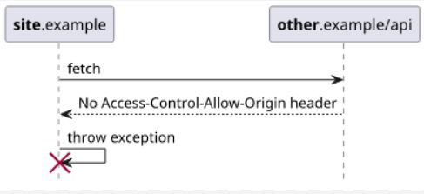
Security Risks & Common Misconﬁgurations
Common security risks:
  Overly permissive CORS
(Access-Control-Allow-Origin: *) → Allows any website to access sensitive data.
  Allowing credentials with *
(Access-Control-Allow-Credentials: true with * origin) → Leads to security vulnerabilities.
  Exposing sensitive APIs via improper CORS settings.
Mitigation Strategies:
  Use a whitelist of trusted origins instead of *.
  Set correct CORS policies for diﬀerent API endpoints.
  Use Reverse Proxies or API Gateways to handle
CORS securely.

Slide 28
Handling CORS in APIs (REST & GraphQL)
CORS in REST APIs:
  JSON-based APIs commonly use CORS.
  Conﬁgure headers properly in backend frameworks (e.g., Express.js, Spring Boot, Django).
CORS in GraphQL APIs:
  GraphQL APIs also need CORS handling since they operate over HTTP.
  Preﬂight requests occur due to complex queries & mutations.

Slide 29
Alternatives to CORS & Role of API Gateways
Alternatives to CORS for Cross-Origin Requests
  Reverse Proxy:
    Forwards client requests to the backend, bypassing browser CORS restrictions.
    Example: Nginx proxying requests to a backend API.
  API Gateway Handling CORS:
    Centralized control of CORS policies for multiple services.
    Example: AWS API Gateway conﬁguring allowed origins.
How API Gateways & Reverse Proxies Help?
  Reverse Proxies handle cross-origin requests internally to avoid CORS issues.
  API Gateways enforce CORS policies centrally, ensuring security & consistency.
  Both improve performance by reducing unnecessary browser preﬂight requests.

Slide 30
Interview Questions on CORS & Web Security
What is the Same-Origin Policy, and why does it exist?
How does CORS enable cross-origin requests?
What is a preﬂight request, and when is it required?
How do you conﬁgure CORS headers on a server?
What are common security risks associated with CORS?
What are alternatives to CORS for handling cross-origin requests?
How do API Gateways and Reverse Proxies help with CORS?

Slide 31
Summary & Key Takeaways
Same-Origin Policy (SOP) restricts cross-origin requests for security reasons.
CORS is a server-side mechanism that allows controlled cross-origin access.
Properly conﬁgured CORS prevents security risks.
Alternatives like backend proxying can bypass CORS when needed.
What’s next:
  Moving to Summary & Practical Applications of Web Concepts.

Slide 32
Section Summary - Web Concepts in System Design
Introduction to Web Concepts
  How web applications work (Client-Server Model, Request-Response Cycle)
  Stateless vs. Stateful interactions
  Importance of security, scalability & performance
Web Sessions: Managing State
  Cookies, Server-Side Sessions, JWTs, Token-Based Authentication
  Security concerns (Session Hijacking, CSRF)
  Best practices for scaling session management
Serialization: Data Exchange & Storage
  Formats: JSON, XML, Protocol Buﬀers,
  Trade-oﬀs: Readability, Eﬃciency, Compatibility
  Serialization in APIs, caching, and databases
CORS & Web Security
  Same-Origin Policy & why CORS is needed
  How CORS works (Preﬂight Requests, Allowed Headers & Methods)
  Common misconﬁgurations & security risks
  API Gateways & Reverse Proxies for CORS handling
What’s next:
  Scalability in System Design

